Slide 1
COMP 3500 Introduction to Operating Systems Memory Management: Part 1
Dr. Xiao Qin
Auburn University http://www.eng.auburn.edu/~xqin
xqin@auburn.edu
Notes:
Fall’16
3 Min: Careers and Skills
25 Min: job scheduling excise
20 Min: 10b2-Project 4-3 Adding System Calls
5 Min: slides 1-5
Fall’15
25 Min: job scheduling excise
25 Min: slides 1-23
Learning objectives of memory management:
To provide a detailed description of various ways of organizing memory hardware
To discuss various memory-management techniques, including paging and segmentation
To provide a detailed description of the Intel Pentium, which supports both pure segmentation and segmentation with paging

Slide 2
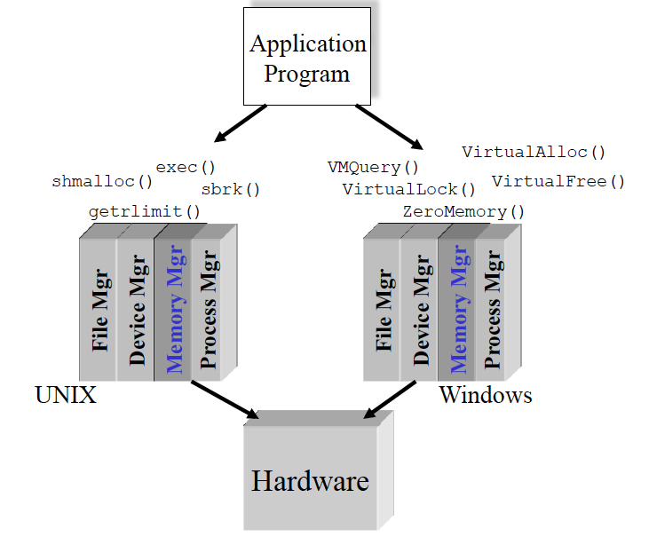
The External View of the Memory Manager
Slide courtesy of Dr. Gary Nutt
Notes:
While surveying the various mechanisms and policies associated with memory management, it is helpful to keep in mind the requirements that memory management is intended to satisfy. These requirements include the following:
• Relocation
• Protection
• Sharing
• Logical organization
• Physical organization

Slide 3
Exercise 1. The Basic Memory Hierarchy. Please rank and compare registers, primary memory, and disks in terms of capacity and speed.
CPU Registers
Less Frequently Used Information
Primary Memory
(Executable Memory)
e.g. RAM
Faster access
Larger storage
More Frequently Used Information
Secondary Memory
e.g. Disk or Tape
Speed?
Capacity?
Slide courtesy of Dr. Gary Nutt
Notes:
While surveying the various mechanisms and policies associated with memory management, it is helpful to keep in mind the requirements that memory management is intended to satisfy. These requirements include the following:
• Relocation
• Protection
• Sharing
• Logical organization
• Physical organization

Slide 4
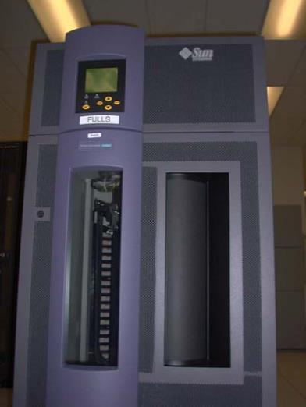
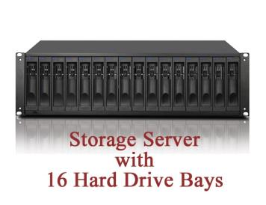

LBNL IT Backup Robotic Tape Libraries URL: servback.lbl.gov/backups/equipment/robots.html
Notes:
In a multiprogramming system, the available main memory is generally shared among a number of processes. Typically, it is not possible for the programmer to know in advance which other programs will be resident in main memory at the time of execution of his or her program. In addition, we would like to be able to swap active processes in and out of main memory to maximize processor utilization by providing a large pool of ready processes to execute. Once a program is swapped out to disk, it would be quite limiting to specify that when it is next swapped back in, it must be placed in the same main memory region as before. Instead, we may need to relocate the process to a different area of memory.

Slide 5
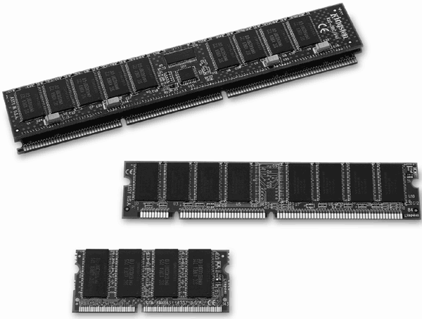
Memory Management Requirements Exercise 2: List two or three functionalities of the memory management
Relocation
Protection
Sharing
Logical organization
Physical organization
Notes:
While surveying the various mechanisms and policies associated with memory management, it is helpful to keep in mind the requirements that memory management is intended to satisfy. These requirements include the following:
• Relocation
• Protection
• Sharing
• Logical organization
• Physical organization

Slide 6
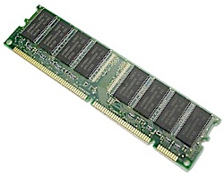
Address Space vs. Primary Memory
Hardware Primary Memory
Process Address Space
Mapped to object
other than memory
Breaking Bad is the greatest TV drama of all-time
Notes:
In a multiprogramming system, the available main memory is generally shared among a number of processes. Typically, it is not possible for the programmer to know in advance which other programs will be resident in main memory at the time of execution of his or her program. In addition, we would like to be able to swap active processes in and out of main memory to maximize processor utilization by providing a large pool of ready processes to execute. Once a program is swapped out to disk, it would be quite limiting to specify that when it is next swapped back in, it must be placed in the same main memory region as before. Instead, we may need to relocate the process to a different area of memory.
Breaking Mad

Slide 7
Creating an Executable Program
Source
code
Library
code
Other
objects
Secondary
memory
C
Reloc
Object
code
Link
Edit
Primary
memory
Compile time: Translate elements
Link time: Combine elements
Loader
Process
address
space
Load time:
Allocate primary memory
Adjust addresses in address space
Copy address space from secondary to primary memory
Notes:
Dynamic Linking
Linking postponed until execution time
Small piece of code, stub, used to locate the appropriate memory-resident library routine
Stub replaces itself with the address of the routine, and executes the routine
Operating system needed to check if routine is in processes’ memory address
Dynamic linking is particularly useful for libraries

Slide 8
A Sample Code Segment
...
static int gVar;
...
int proc_a(int arg){
...
gVar = 7;
put_record(gVar);
...
}

Slide 9
The Relocatable Object Module
Code Segment
Relative Address Generated Code
0000 ...
...
0008 entry proc_a
...
0220 load =7, R1
0224 store R1, 0036
0228 push 0036
0232 call ‘put_record’
...
0400 External reference table
...
0404 ‘put_record’ 0232
...
0500 External definition table
...
0540 ‘proc_a’ 0008
...
0600 (symbol table)
...
0799 (last location in the code segment)
Data Segment
Relative Address Generated variable space
...
0036 [Space for gVar variable]
...
0049 (last location in the data segment)

Slide 10
The Absolute Program After the link editor combines relocatable modules
Code Segment
Relative Address Generated Code
0000 (Other modules)
...
1008 entry proc_a
...
1220 load =7, R1
1224 store R1, 0136
1228 push 1036
1232 call 2334
...
1399 (End of proc_a)
... (Other modules)
2334 entry put_record
...
2670 (optional symbol table)
...
2999 (last location in the code segment)
Data Segment
Relative Address Generated variable space
...
0136 [Space for gVar variable]
...
1000 (last location in the data segment)
Q3: What is the difference
Between the absolute program and the relocatable object module?
Notes:
Question: What is the difference?
After the link editor combines relocatable modules

Slide 11
The Program Loaded at Location 4000
Relative
Address Generated Code
0000 (Other process’s programs)
4000 (Other modules)
...
5008 entry proc_a
...
5036 [Space for gVar variable]
...
5220 load =7, R1
5224 store R1, 7136
5228 push 5036
5232 call 6334
...
5399 (End of proc_a)
... (Other modules)
6334 entry put_record
...
6670 (optional symbol table)
...
6999 (last location in the code segment)
7000 (first location in the data segment)
...
7136 [Space for gVar variable]
...
8000 (Other process’s programs)

Slide 12
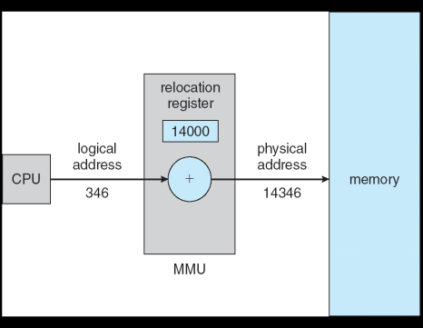
Dynamic Relocation using a Relocation Register
Hardware device that maps virtual to physical address
The value in the relocation register is added to every address generated by a user process at the time it is sent to memory
The user program deals with logical addresses; it never sees the real physical addresses

Slide 13
Static Memory Partitioning
Unused
Operating
System
In Use
Used in several variations in some now-obsolete operating systems
Does not involve virtual memory
Process 3
p_{i}
Process 0
Issue:
Need a mechanism/policy for loading p_{i}’s address space into primary memory
Process 2
Process 1
Notes:
The principal operation of memory management is to bring processes into main memory for execution by the processor. In almost all modern multiprogramming systems, this involves a sophisticated scheme known as virtual memory. Virtual memory is, in turn, based on the use of one or both of two basic techniques: segmentation and paging. Before we can look at these virtual memory techniques, we must prepare the ground by looking at simpler techniques that do not involve virtual memory ( Table 7.2 summarizes all the techniques examined in this chapter and the next). One of these techniques, partitioning, has been used in several variations in some now-obsolete operating systems. The other two techniques, simple paging and simple segmentation, are not used by themselves. However, it will clarify the discussion of virtual memory if we look first at these two techniques in the absence of virtual memory considerations.

Slide 14
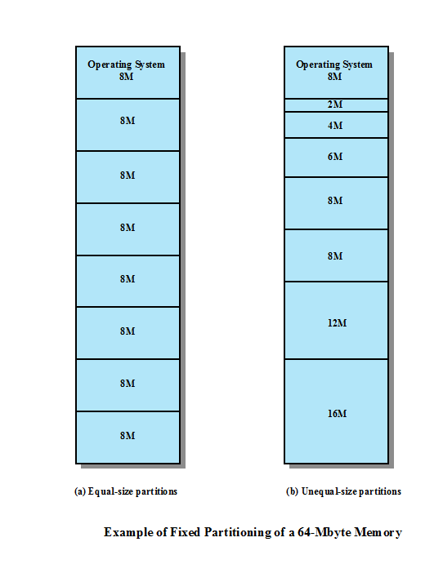
Notes:
In most schemes for memory management, we can assume that the OS occupies some fixed portion of main memory and that the rest of main memory is available for use by multiple processes. The simplest scheme for managing this available memory is to partition it into regions with fixed boundaries.
PARTITION SIZES Figure 7.2 shows examples of two alternatives for fixed partitioning. One possibility is to make use of equal-size partitions. In this case, any process whose size is less than or equal to the partition size can be loaded into any available partition. If all partitions are full and no process is in the Ready or Running state, the operating system can swap a process out of any of the partitions and load in another process, so that there is some work for the processor.

Slide 15
Frame vs. Page vs. Segment
Memory Management Terms
Notes:
In a uniprogramming system, main memory is divided into two parts: one part
for the operating system (resident monitor, kernel) and other part for the program
currently being executed. In a multiprogramming system, the “user” part of
memory must be further subdivided to accommodate multiple processes. The task
of subdivision is carried out dynamically by the operating system and is known as
memory management .
Effective memory management is vital in a multiprogramming system. If only
a few processes are in memory, then for much of the time all of the processes will be
waiting for I/O (input/output) and the processor will be idle. Thus memory needs to
be allocated to ensure a reasonable supply of ready processes to consume available
processor time.
Table 7.1 introduces some key terms for our discussion.

Slide 16
Static Memory Allocation (Cont.)
Hole – block of available memory; holes of various size are scattered throughout memory
When a process arrives, it is allocated memory from a hole large enough to accommodate it
Operating system maintains information about: a) allocated partitions b) free partitions (hole)
OS
OS
OS
OS
process 5
process 5
process 5
process 5
process 9
process 9
process 8
process 10
process 2
process 2
process 2
process 2

Slide 17
Fixed-Partition Memory Mechanism
Operating
System
p_{i} needs n_{i} units
Region 0
N₀
n_{i}
p_{i}
Region 1
N₁
Region 2
N₂
Region 3
N₃

Slide 18
Fixed-Partition Memory Best-Fit
Loader must adjust every address in the absolute module when placed in memory
Operating
System
Region 0
N₀
Region 1
N₁
Internal
Fragmentation
Exercise 3: Pros and Cons?
p_{i}
N₂
Region 2
Region 3
N₃

Slide 19
Fixed-Partition Memory Worst-Fit
Operating
System
Exercise 4: Pros and Cons?
p_{i}
Region 0
N₀
Region 1
N₁
Region 2
N₂
Region 3
N₃
Notes:
Timesharing systems forced OS away from fixed-partition strategies

Slide 20
Fixed-Partition Memory First-Fit
Operating
System
Exercise 5: Pros and Cons?
p_{i}
Region 0
N₀
Region 1
N₁
Region 2
N₂
Region 3
N₃

Slide 21
Fixed-Partition Memory Next-Fit
Operating
System
Exercise 6: Pros and Cons?
Fixed-Partition strategies were used in batch multiprogramming systems (why?)
Not good for timesharing systems
Region 0
N₀
p_{i}
Region 1
N₁
P_{i+1}
Region 2
N₂
Region 3
N₃
Notes:
Know memory requirement in advance

Slide 22
Disadvantages
A program may be too big to fit in a partition
program needs to be designed with the use of overlays
Main memory utilization is inefficient
any program, regardless of size, occupies an entire partition
internal fragmentation
wasted space due to the block of data loaded being smaller than the partition
Notes:
There are two difficulties with the use of equal-size fixed partitions:
• A program may be too big to fit into a partition. In this case, the programmer must design the program with the use of overlays so that only a portion of the program need be in main memory at any one time. When a module is needed that is not present, the user’s program must load that module into the program’s partition, overlaying whatever programs or data are there.
• Main memory utilization is extremely inefficient. Any program, no matter how small, occupies an entire partition. In our example, there may be a program whose length is less than 2 Mbytes; yet it occupies an 8-Mbyte partition whenever it is swapped in. This phenomenon, in which there is wasted space internal to a partition due to the fact that the block of data loaded is smaller than the partition, is referred to as internal fragmentation .

Slide 23
Summary
Memory Management Requirements
Dynamic Relocation using a Relocation Register
Static Memory Partitioning
Frame vs. Page vs. Segment

